Slide 1

TensorFlow 2.0
PRACTICAL

Slide 2
PROJECT #6 OVERVIEW

Slide 3

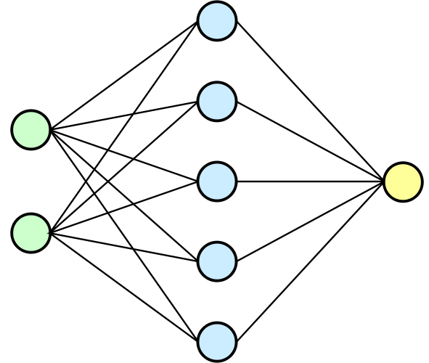
PROJECT #6: DIABETES CLASSIFICATION
PREGNANCIES
TRAINED ARTIFICIAL NEURAL NETWORK MODEL
BLOODPRESSURE
INSULIN
DIABETES OR NOT
BMI
Photo Credit: https://commons.wikimedia.org/wiki/File:Neural_network.svg
TensorFlow 2.0 PRACTICAL

Slide 4
PROJECT #6: DIABETES CLASSIFICATION
This dataset is used to predict whether or not a patient has diabetes, based on given features/diagnostic measurements.
Only female patients are considered with at least 21 years old of Pima Indian heritage.
INPUTS:
Pregnancies: Number of times pregnant
GlucosePlasma: glucose concentration 2 hours in an oral glucose tolerance test
BloodPressure: Diastolic blood pressure (mm Hg)
Skin: ThicknessTriceps skin fold thickness (mm)
Insulin: 2-Hour serum insulin (mu U/ml)
BMI: Body mass index (weight in kg/(height in m)^2)
DiabetesPedigreeFunction: Diabetes pedigree function
Age: Age (years)
OUTPUTS:
Diabetes or no diabetes (0 or 1)
INPUTS
DIABETES
OR NOT
CLASSIFICATION MODEL
TensorFlow 2.0 PRACTICAL

Slide 5
PROJECT #6: DIABETES CLASSIFICATION
Acknowledgements Smith, J.W., Everhart, J.E., Dickson, W.C., Knowler, W.C., & Johannes, R.S. (1988). Using the ADAP learning algorithm to forecast the onset of diabetes mellitus. In Proceedings of the Symposium on Computer Applications and Medical Care (pp. 261--265). IEEE Computer Society Press.
TensorFlow 2.0 PRACTICAL

